Slide 1

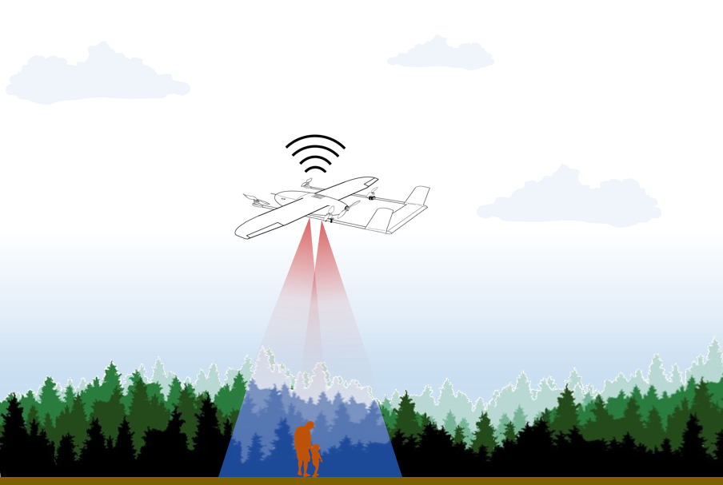
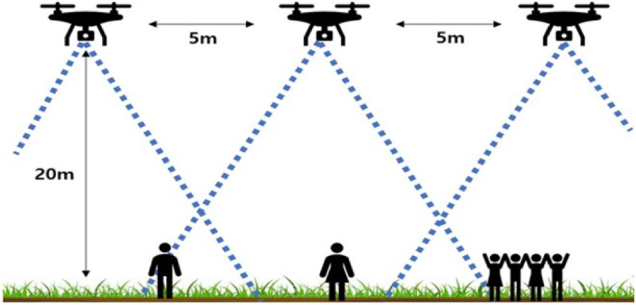
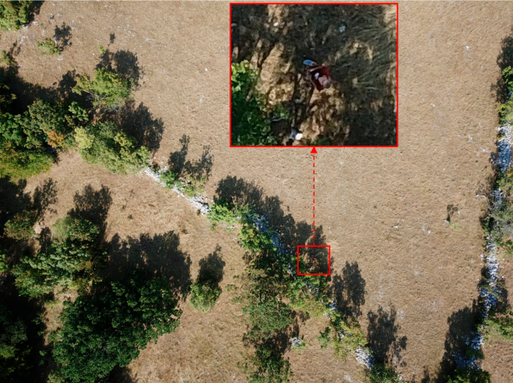
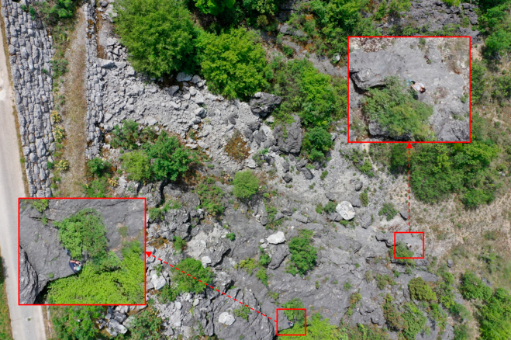
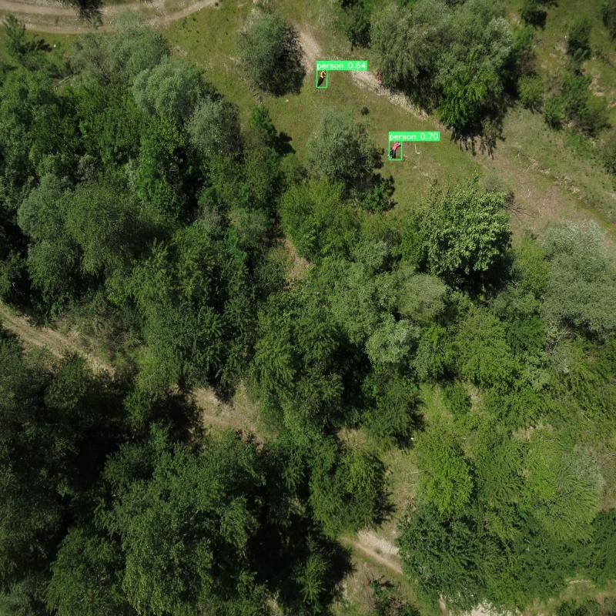
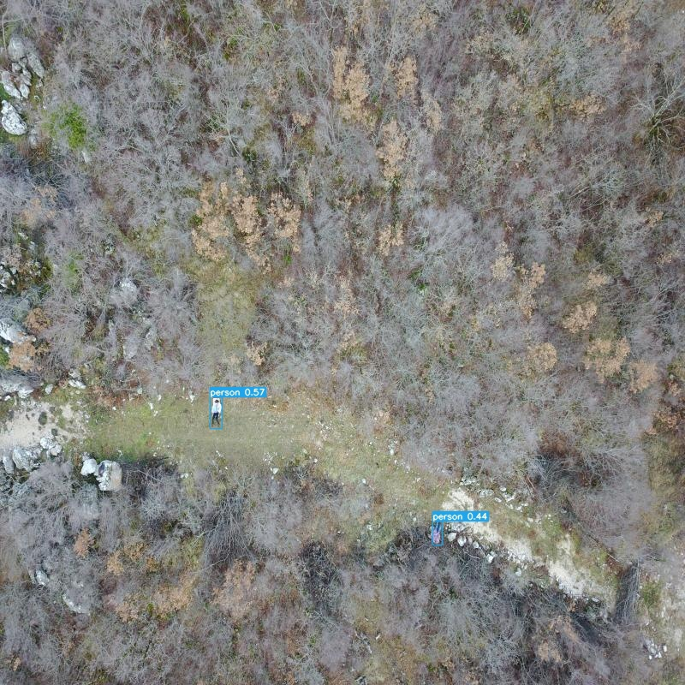
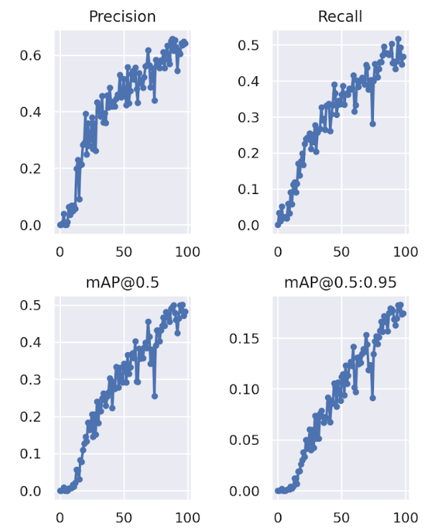
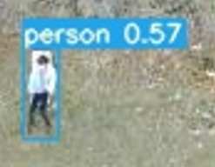
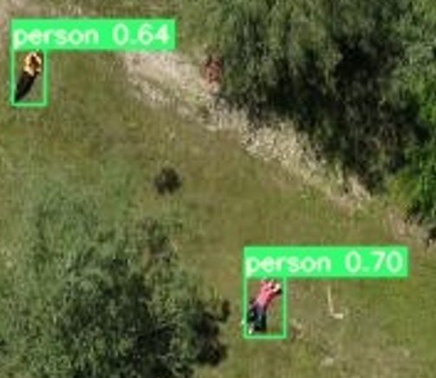



University of Peradeniya
Deep Learning Based Human Detection System for Search and Rescue
K.A.Weerasekara¹ , R.B.S.W.M.L.R.B.Wanninayake¹ , D.S.Perera¹
Prof.Maheshi Dissanayake¹
¹Department of Electrical and Electronic Engineering, Faculty of Engineering, University of Peradeniya.
Abstract- This project focuses on improving search and rescue operations in disaster-stricken areas by leveraging the capabilities of unmanned aerial vehicles (UAVs) or drones. Traditional methods for search and rescue can be slow and labor-intensive, especially in challenging environmental conditions. UAVs equipped with high-resolution cameras and embedded GPUs offer a more efficient solution. These drones can cover large areas quickly, provide detailed terrain information, and offer a bird's-eye view of remote and hostile environments, all while reducing the need for a large team on the ground. The project's key objective is to assess the potential of modern deep learning models, specifically YOLOv7, for UAV-based search and rescue operations.
Introduction
Search-and-Rescue (SAR) is the search for people in danger or imminent danger to rescue them.
Traditional human detection methods in search and rescue often lack accuracy and efficiency.
We Develop intelligent system for precise human detection to revolutionize search and rescue missions.
Challenges in SAR
Rescue operations must be performed quickly, as any delay can potentially cause injury or even human loss.
Environments in which they are performed are often challenging
In the case of post disaster scenes
Low light situations.
Highly diverse environments
Detect human from high altitudes.
Data
Data Preprocessing
Processed Data
Train the model
Finetune the hyperparameters through experiments
Get results
Test the model
Methodology
YOLOv7 model for SAR human detection
New dataset was created using, SARD and HERIDAL datasets.
Training set – 2467 images
Validation set – 520 images
Test set – 520 images
Results
Precision, Recall & mAP values of the model during the training process
The model shows 70% accuracy on the Test data set
Conclusion
YOLOv7 model was able to detect human in high resolution frames of various environments with good accuracy. It is also able to predict quickly (1.5ms average time per frame) which is essential in Search and Rescue missions.
Contact details
Name : Prof.Maheshi Dissanayake
Tel. No.: +94 812 393437
Email : maheshid@eng.pdn.ac.lk
Department of Electrical and Electronic Engineering
Faculty of Engineering
University of Peradeniya
Peradeniya, 20400, Sri Lanka
Dept. of Electrical and Electronic Engineering
Faculty of Engineering
University of Peradeniya
Peradeniya, 20400, Sri Lanka

